Slide 1

A Project Report on
Converting Natural Language Query to SQL Query
Group Members
Group Number
Under the guidance of
Buddhaditya Rath
Vivek Repale
24
Prof. Preeti S. Satao
Dhairya Timbadia
Department of Computer Engineering
University of Mumbai
April 2020

Slide 2
Introduction
The main purpose of Natural Language Query Processing is for the interpretation of the English sentences by computer.
Natural Language Processing can be used to access the database by asking questions in Natural Language and getting the required results.
In natural language to databases is a very convenient and easy method of data access, especially for users who do not have knowledge about the complicated database handling query languages such as SQL (Structured Query Language).

Slide 3
Literature Survey
SQL is opportunistic for its distinctive, high level language and close connection to the underlying data.
To create a system which can generate a SQL query from natural language we need to make the system which can understand natural language.
Most of the research done until now solves this problem by teaching a system to identify the parts of speech of a particular word in the natural language which is called tagging.
After this the system is made to understand the meaning of the natural query when all the words are put together which is called parsing.

Slide 4
Problem Statement
This project makes use of natural language processing techniques to work with text data to form SQL queries with the help of a corpus which has been developed.
En2sql is given a plain English language as input returns a well-structured SQL statement as output.

Slide 5
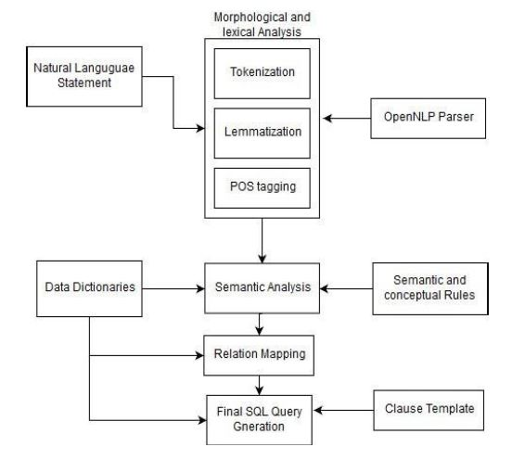
System Architecture
The proposed approach aims to use knowledge of SQL to create a corpus which will help to identify SQL command words i.e. SELECT, INSERT, DELETE, UPDATE and map the tokens with appropriate POS.
Word similarities will be calculated with the input tokens to the database schema (table names, column names, data) to insert table names, column names, and data comparisons into the query.

Slide 6
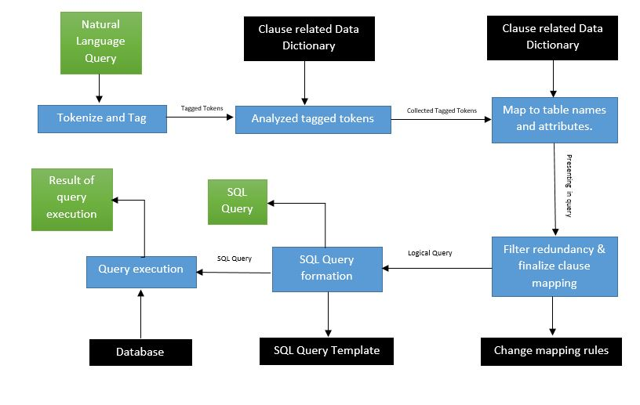
System Workflow

Slide 7
Methodology
The research will start by focusing on statements (“get / find number of employees”) and then extend to questions (“Who is Bob?”). The statements are easier as it gives more keywords to interpolate the SQL query structure.
There are many relations databases. While their SQL syntax is similar, it can differ for more complicated queries. We will focus on Oracle SQL as it is an open source database with a large user base

Slide 8
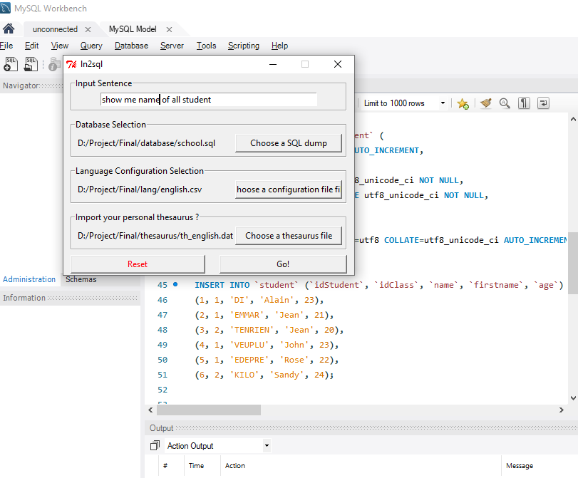
Output (1/3)
Dry Running on MySQL WorkBench by selecting
Database
Language configuration
Language Thesaurus.

Slide 9
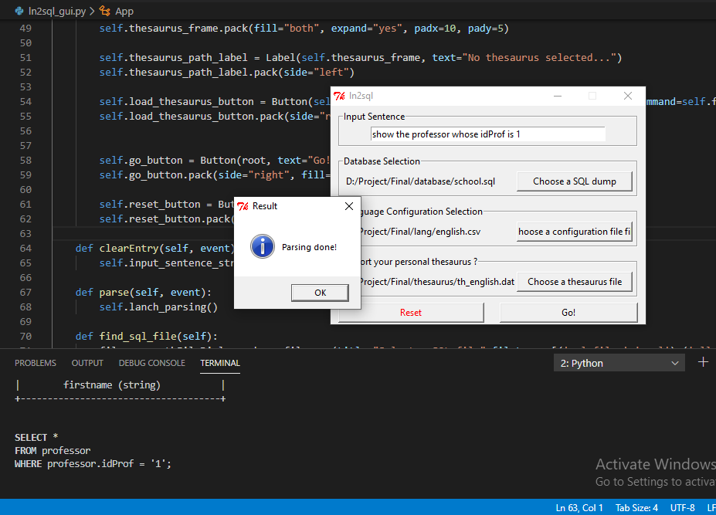
Output (2/3)
Usage of clauses like –
CONSTRAINT clause
EXTERNAL NAME clause
FROM clause,
GROUP BY clause
HAVING clause
WINDOW clause
ORDER BY clause
USING clause
WHERE clause

Slide 10
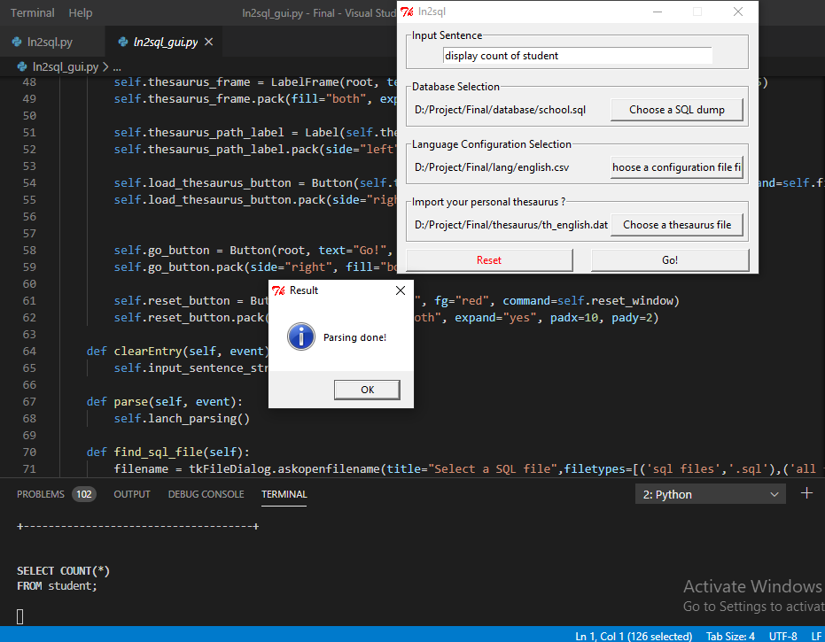
Output (3/3)
The use of Synonyms also works from the Natural Language data dictionary.
For example – the use of the words like ‘show‘ is replaced by a synonym of it by the word ‘display’.

Slide 11
Comparative Study/Analysis (1/2)
Analyzing the custom bag of words using LSTM based RNN network and verify how the performance of system changes. Instead of using trivial NLP techniques like NLTK, custom corpus we wanted to use Stanford NER library which contains all the known words with tags.
Stanford NER word library
Using thesaurus to match input tokens not only to the table and column names but their synonyms as well would greatly increase our accuracy and chances a natural language token would be matched to a correct corpus name.
Use of Thesaurus

Slide 12
Comparative Study/Analysis (2/2)
Next changes to be implemented are better column value matching. An input token to a column value (as opposed to a column or table name). Using the LIKE MySQL syntax with %% to find column values. Only evaluate nouns in this case & count the number of rows that contain the token and use the column with the highest count.
Use of MySQL for best column values
We have not addressed abbreviations in this project. Simply, a corpus of English abbreviations would be used to map from common words to abbreviations and vise versa.
Use of Corpus

Slide 13
Conclusion
An opportunity to come up with a solution for writing tedious queries.
Resolving basic queries and can made powerful to handle complex Queries, Normalization and also can be extended for NoSQL.
With an accuracy of about 30-50% in basic queries.

Slide 14
References
A Natural Language Database Interface Based on a Probabilistic Context Free Grammar, IEEE International Workshop on Semantic Computing
© 2008 IEEE DOI 10.1109/WSCS.2008.14
Generic Interactive Natural Language Interface to Databases (GINLIDB), Proceedings of the WSEAS International Conference on Evolutionary Computing.
ISSN : 1790-5109 ISBN : 978-960-474-067-3
Natural Language Query Processing Using Semantic Grammar by Gauri Rao.
(IJCSE) International Journal on Computer Science and Engineering Vol.02
ISSN 0975-3397

